Slide 1


SEGEN × EARTH CARE CONSULTING
A National Deposit Return System for the United Arab Emirates
Feasibility & implementation proposal to the Ministry of Economy & Tourism and the Ministry of Climate Change & Environment
JULY 2026 · CONFIDENTIAL
Notes:
Who is asking and for what - Segen with Earth Care Consulting proposes a national DRS to MOET and MOCCAE.

Slide 2
WHY NOW
The last single-use stream standing.
The UAE is among the world's highest bottled-water consumers (~265 litres per capita, WAM). The federal single-use plastics ban was completed on 1 January 2026 - beverage containers are now the dominant remaining stream.
3.7bn
~440m
<50%
containers placed on the market each year - PET 2.9bn · cans 660m · glass ~0.2bn (modelled)
aluminium cans landfilled every year (EGA, 2024)
what voluntary collection achieves - vs a 91% median where deposits apply (Reloop, 2026)
Sources: WAM; EGA, 2024; Reloop, 2026; Segen modelling (R7 assumptions).
CONFIDENTIAL
02
Notes:
Feel the gap - the ban is done, bottles and cans are the last stream, and voluntary collection cannot close it.

Slide 3
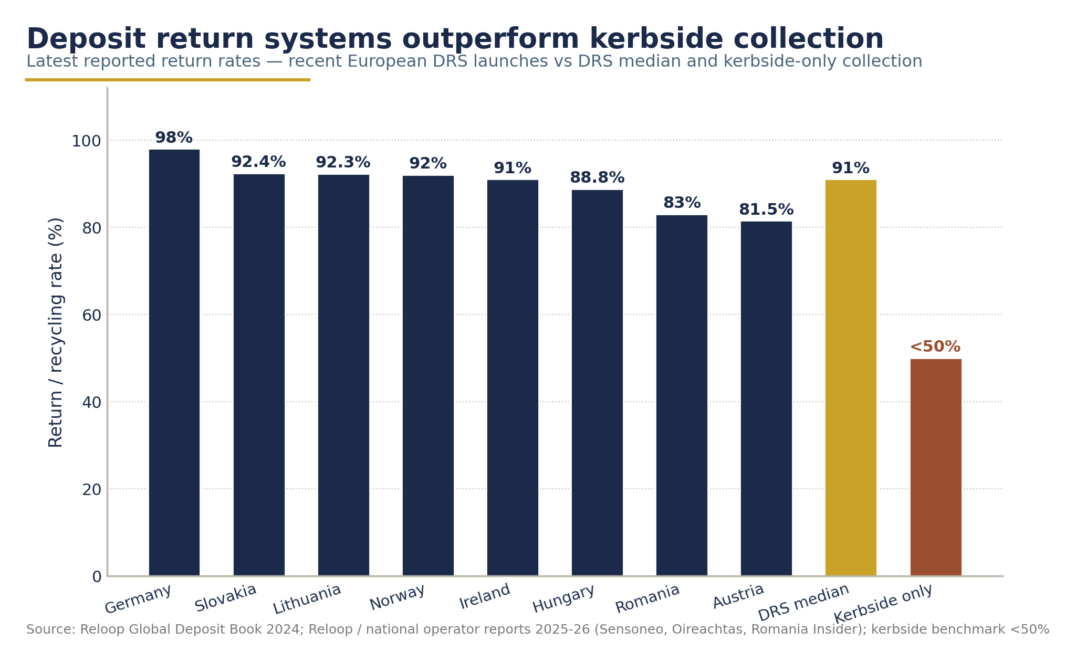
PROVEN, NOT THEORETICAL
Deposit systems return 9 of every 10 containers.
34% → 92%
Lithuania - within two years of launch (USAD, 2023)
83%
Romania - in its second year of operation (RetuRO, 2025)
49% → 91%
Ireland - within its first year (Re-turn, 2025)
60 jurisdictions · 396M people
now live with deposit return systems worldwide (Reloop, 2026)
Global return rates by collection system. Source: Reloop, 2026.
Sources: Reloop, 2026; USAD, 2023; RetuRO, 2025; Re-turn, 2025.
CONFIDENTIAL
03
Notes:
Believe it works - deposits are proven across 60 jurisdictions; the newest systems hit 90% within two years.

Slide 4
THE PROPOSAL
AED 0.25. Fully refundable.
Every bottle, can and jar - nationwide.
1 · BUY
2 · RETURN
3 · REFUND
4 · RECYCLE
Deposit included at the till
RVM or collection point
Voucher · cash · digital wallet · donate
Counted, sorted, remade in the UAE
A closed national loop - every return re-enters the system
Deposit level is a recommended, non-binding parameter.
CONFIDENTIAL
04
Notes:
The mechanism in ten seconds - a quarter-dirham refundable deposit moving through a closed national loop.

Slide 5
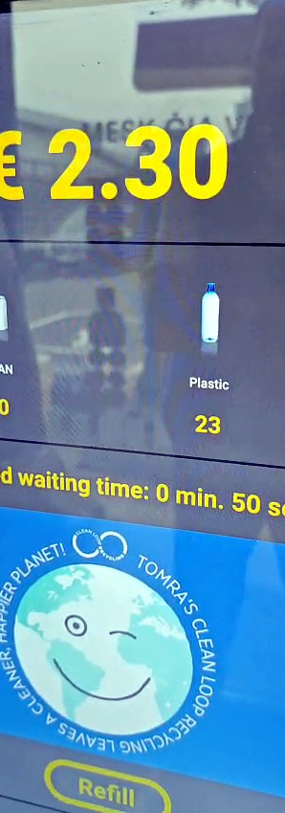
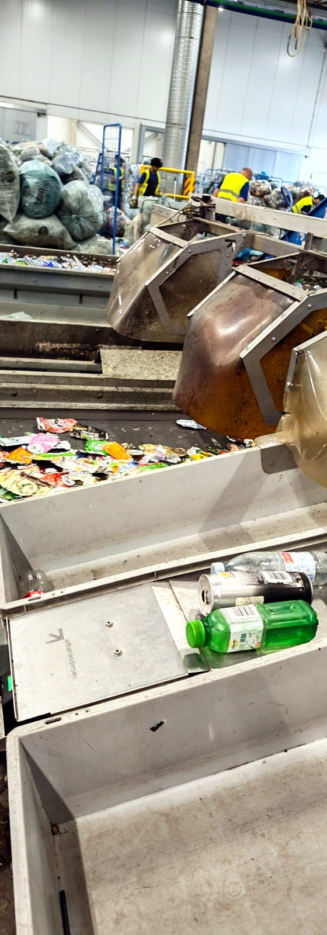
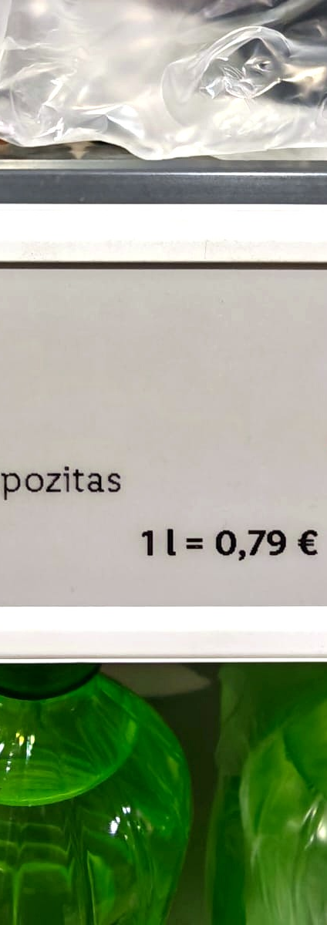
NATIONAL INFRASTRUCTURE
One network, every emirate.
3,500
reverse vending machines across retail and public locations
~5,500
manual collection points - ≈1 return point per 1,250 residents
3
counting & sorting centres
1
national IT clearing platform, with real-time ministry reporting
European benchmark operations - Lithuania
Source: Segen DRS deployment model (R7 assumptions), 2026.
CONFIDENTIAL
05
Notes:
See it is concrete - a national return network on the European benchmark model, sized for every emirate.

Slide 6
GOVERNANCE
Segen earns nothing from unclaimed deposits.
A not-for-profit Deposit System Operator under government supervision.
Every deposit sits in a ring-fenced escrow, publicly reported.
Segen's income: operations management and recovered-material value - only.
CONFIDENTIAL
06
Notes:
Trust the operator - Segen never touches unredeemed deposits; every dirham sits in a supervised escrow.

Slide 7
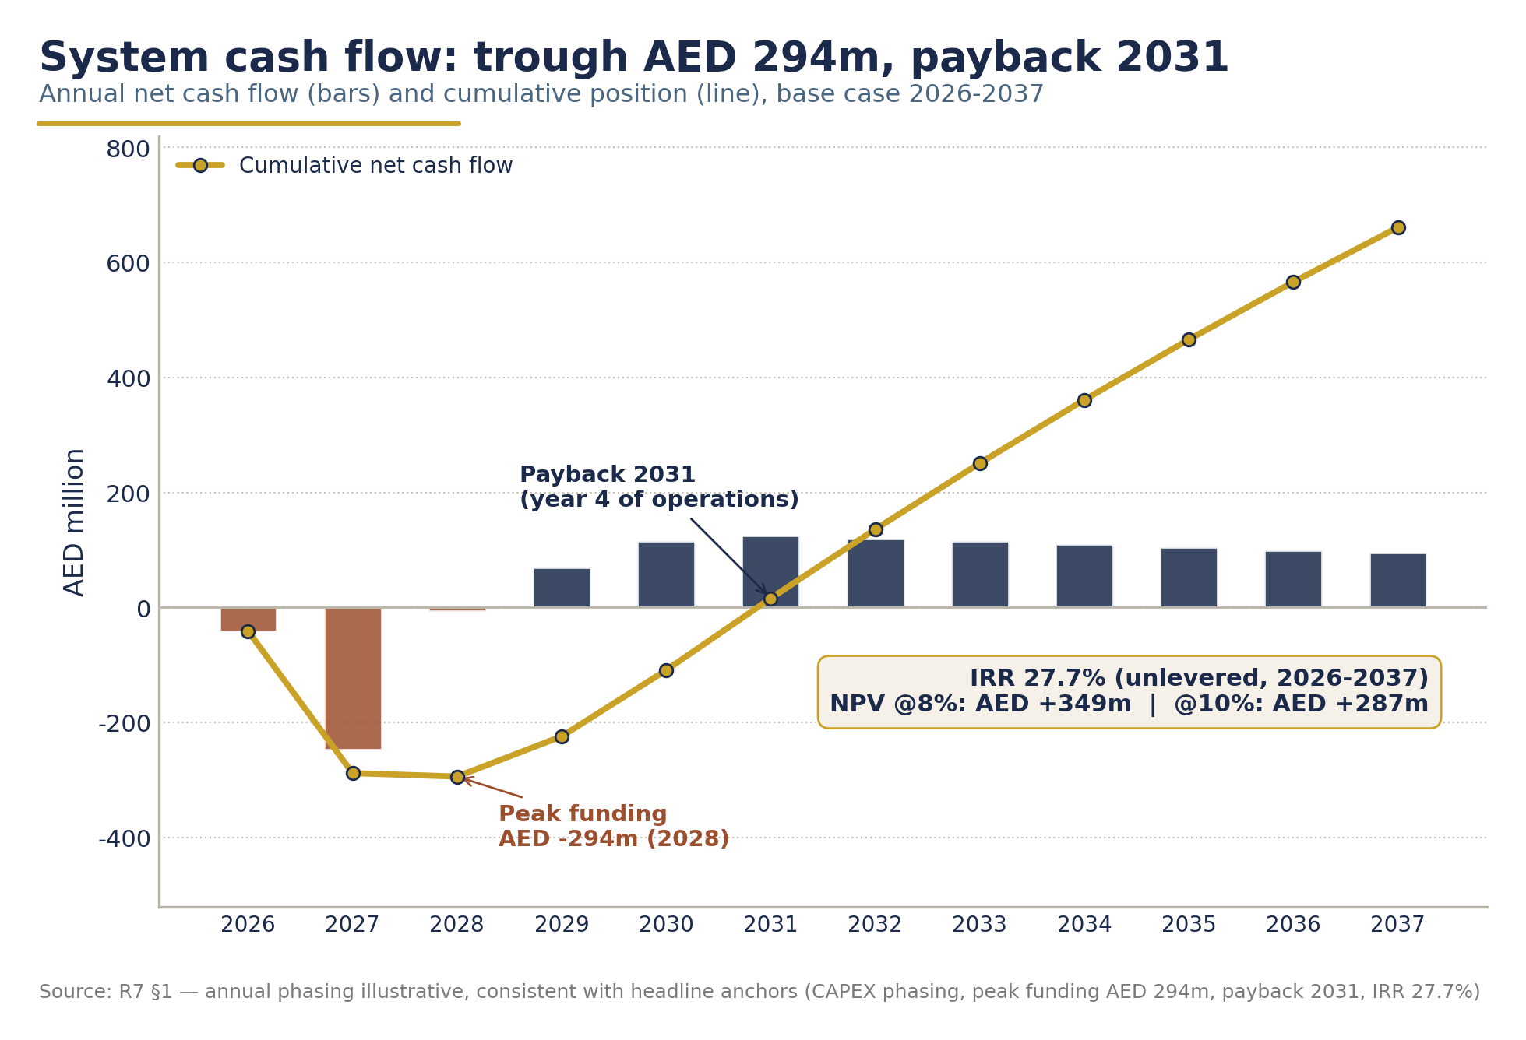
SELF-FINANCING
No government funding required.
AED 664m
27.7%
2031
+AED 349m
private capital programme
system IRR (unlevered)
payback, year 4 of operations
NPV @ 8% discount rate
FUNDED BY PRODUCERS
Producer responsibility fees fund operations: AED 0.20 per PET container, AED 0.08 per aluminium can, AED 0.24 per glass container. Recommended, non-binding.
Deposits sit in a ring-fenced escrow and are never treated as revenue.
Source: Segen DRS financial model (R7 assumptions), 2026.
CONFIDENTIAL
07

Slide 8
WHAT THE UAE GETS
A circular-economy flagship.
90%
≈3.8bn
1,200-1,500
return rate achieved by 2034
containers recovered every year at maturity
direct jobs in collection, logistics and processing
FEEDSTOCK FOR UAE RECYCLERS
Recovered PET and aluminium return to the national economy as feedstock for UAE recyclers - Repeet (rPET), Emirates Global Aluminium and DGrade - keeping material value onshore.
DELIVERS THE NATIONAL AGENDA
UAE Circular Economy Policy 2021-2031 · Net Zero 2050 · NDC 3.0 · Dubai Integrated Waste Management 2041
Source: Segen DRS financial model (R7 assumptions), 2026.
CONFIDENTIAL
08

Slide 9
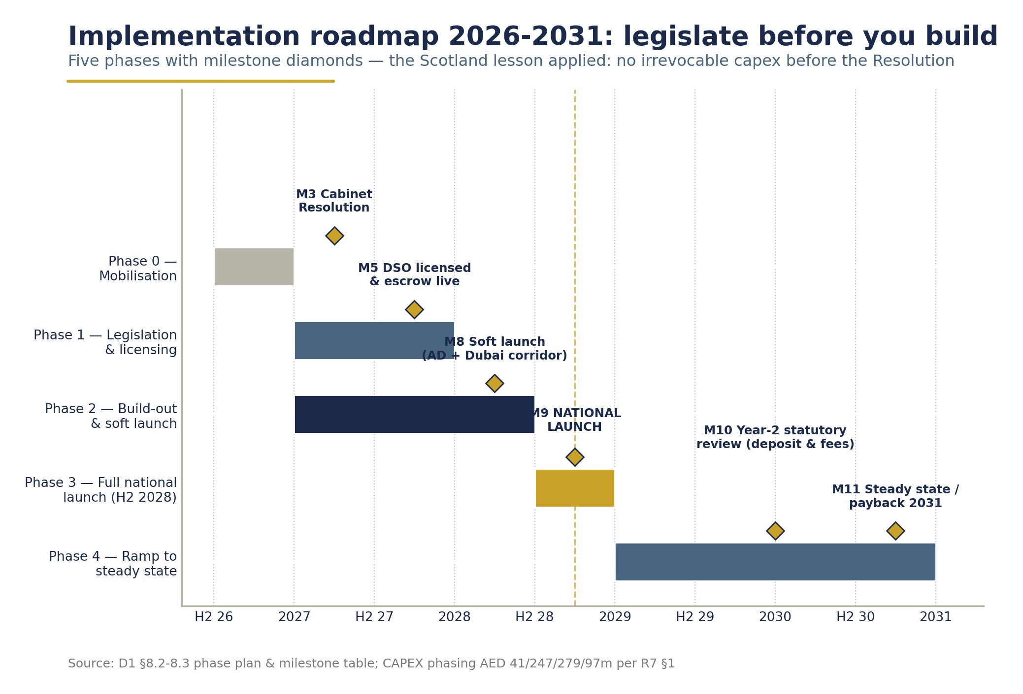
18-24 MONTHS TO LAUNCH
From approval to national operation.
Legal framework 2027 → Build-out & soft launch → National launch - H2 2028 → 90% return rate by 2034
Benchmarks: Lithuania reached national operation in 18 months; Ireland in ~24.
CONFIDENTIAL
09

Slide 10
WHO DELIVERS
Government sets the rules. We build and run the system.
GOVERNMENT
SEGEN
EARTH CARE CONSULTING
Sponsorship & supervision
Sponsor & operator
Design & implementation
Ministerial sponsorship, the legal framework, and ongoing supervision of the Deposit System Operator.
Alliance architecture, private capital, and build-out and operation of the national return network.
DRS design and implementation, with a track record from Iceland to the UK - including the Lithuania launch in 2016.
One accountable operator, under government supervision.
CONFIDENTIAL
10

Slide 11
WHAT WE ASK OF YOU
Five decisions.
1
Ministerial sponsorship of the national DRS initiative.
2
A legal framework - the Cabinet Resolution pathway under Federal Law No. 12 of 2018.
3
A supervisory mandate, with a seat on the DSO board.
4
Facilitation of collection-point siting - retail, fuel stations and public locations.
5
Integration with the national EPR framework.
No budget allocation is requested.
CONFIDENTIAL
11

Slide 12
The architecture between ambition and infrastructure.
Saif Bin Khadia - Managing Partner · Amr Konsowa - Managing Director
Segen · BK Building, Oud Metha, Dubai
CONFIDENTIAL
12

